Slide 1
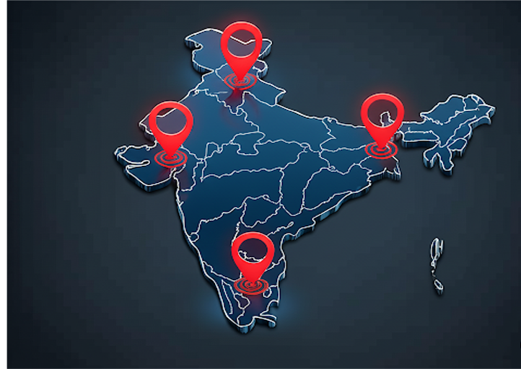
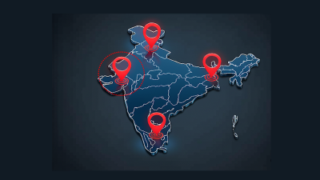


Slide 3
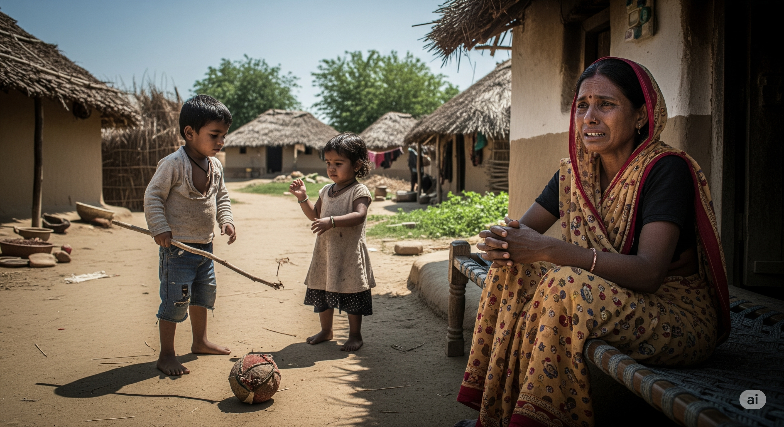
I didn’t make savings ! How am I going to feed my kids ?

Slide 4
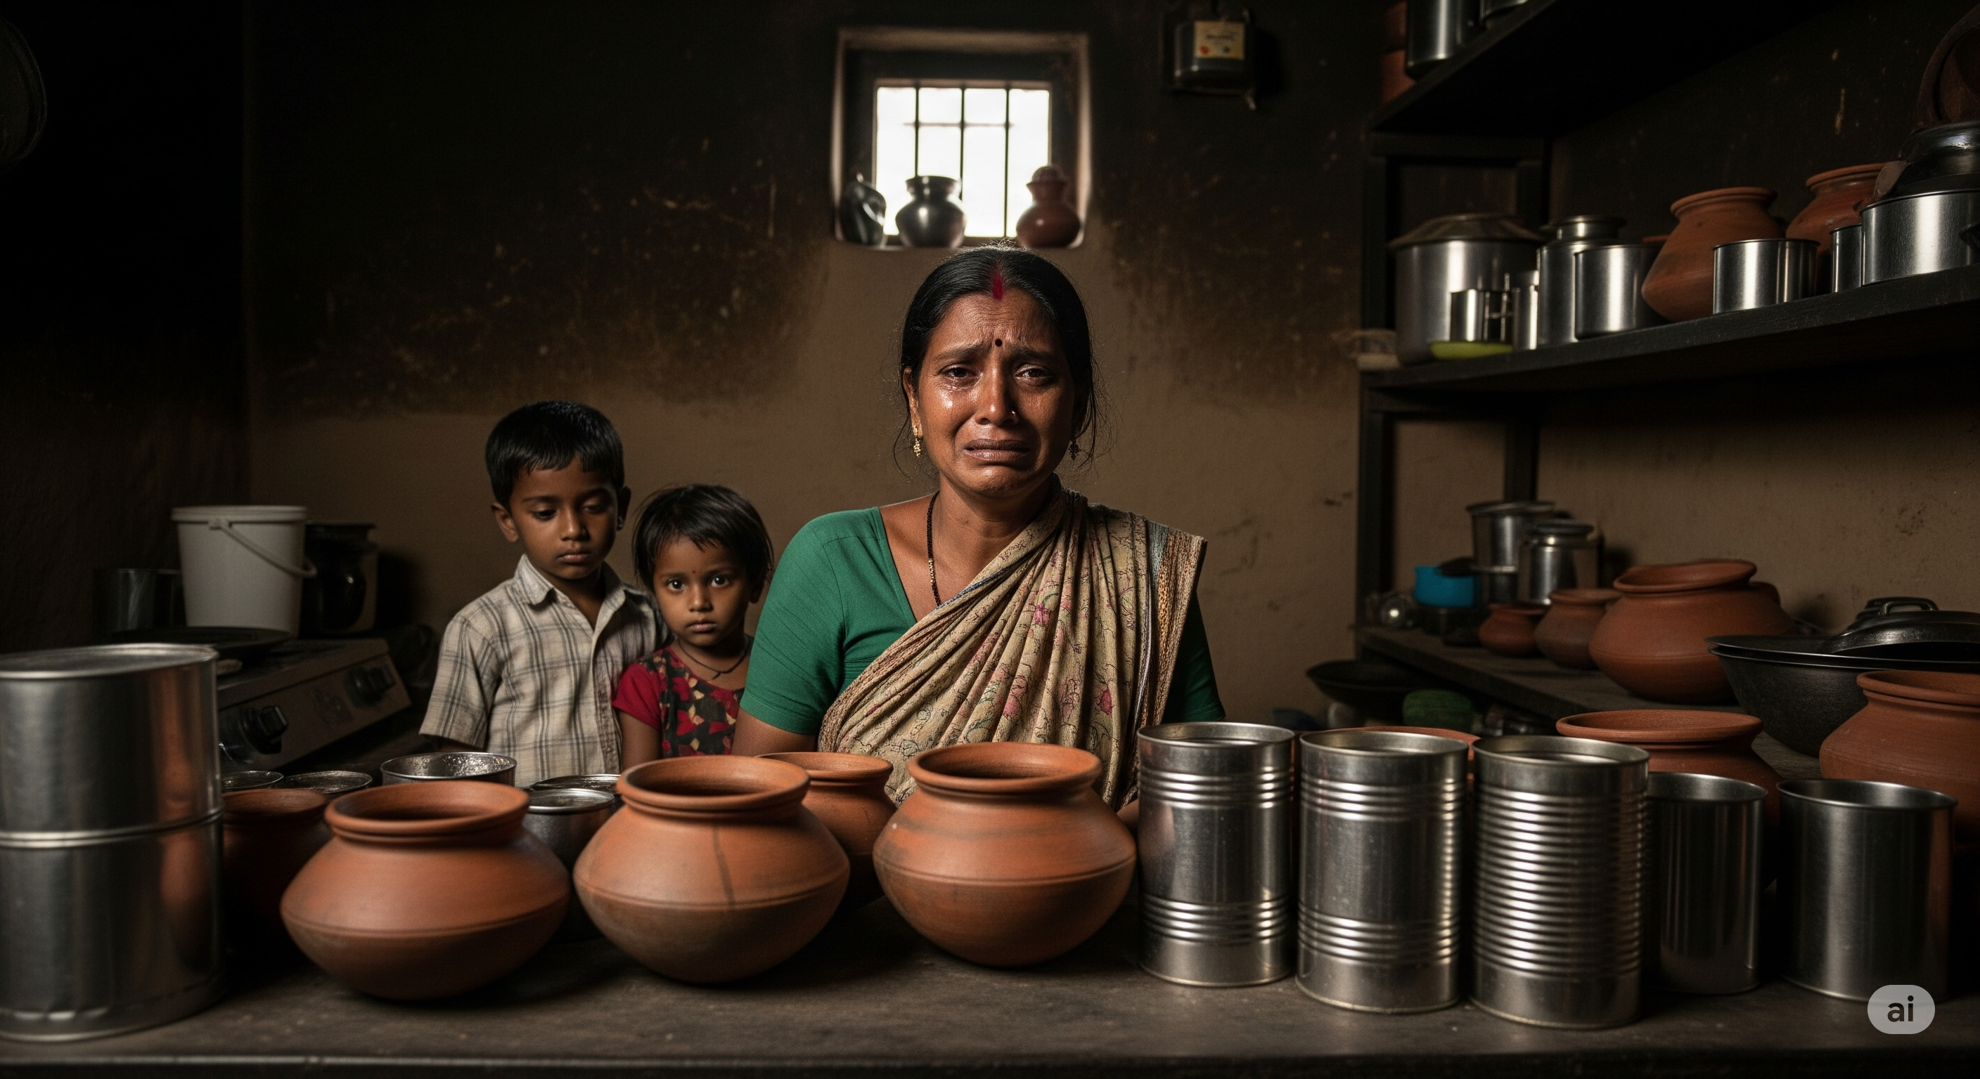
Why didn’t we get any information about Life Insurance ?

Slide 5

THIS ISN’T RARE !
In India, millions of families vanish into debt and poverty after the breadwinner is gone — not because they didn’t care… but because insurance never reached them.

Slide 6
All the ideas we ll list

Slide 7


Slide 9
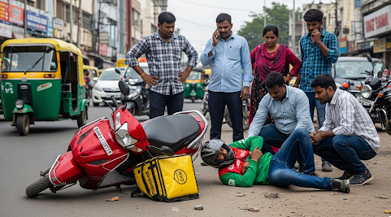
I wish he had taken life insurance so that his family won’t suffer.

Slide 10
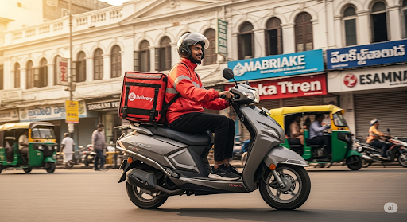
I have already taken life insurance unlike my friend when I made UPI payment. I can now drive safely knowing that my family is protected.

